Slide 1


SEICHE 2023 Intermediate Arduino Programming for IoT
Instructor: Paul Frommeyer
www.paulfrommeyer.com
Corporate Sponsor: DXC Technology

Slide 2
REMINDER YOU MUST HAVE A WORKING LED MATRIX DISPLAY TO TAKE THIS CLASS! If displays are lost or damaged, replacements are $70 with 1-week lead time for replacement

Slide 3
Lesson Plan Overview
Lesson 1: 7Feb23 – Review, Addressing, and Pointers
Overview of lesson plan
Class Exercise: Validation of sketch uploading
Class Exercise: Validation of binary create and upload
More on the Preprocessor
Memory Organization and Variables
Review of addressing and pointers
Using pointers to variables
Declaring pointers in function calls
Call-by-value Function Calls
Call-by-reference Function Calls
Lesson 2: 14Feb23 – More Gory Details
Class Exercise: Call-by-reference variables
Introduction to Complex Data Structures
Using complex data structures
Storage declarations and Arduino
Lesson 3: 21Feb23 – Fonts Redux
MD_Parola library font usage review
The MD_Parola font format
Designing your own fonts
Declaring your own fonts
Using your own fonts with MD_Parola
Lesson 4: 28Feb23 – Intro to Visual Studio Code
Introduction to VSC
https://code.visualstudio.com/docs/introvideos/overview
VSCode Installation
VSCode Integration with Arduino and ESP8266
Lesson 5: 7Mar23 – Filesystems
Introduction to mass storage filesystems
The SD FAT, FAT16, and FAT32 filesystems
The exFAT filesystem
Introduction to SPIFFS
Class Exercise: Using SPIFFS
Lesson 6: 14Mar23 – WiFi
Review of WiFi technology (but no gory details)
Class Exercise: Review of WiFi access with WiFi Manager
Creating access points with ESP8266
Class Exercise: Creating an access point
Lesson 7: 21Mar23 – Web Technology
Introduction to HTML
Web server and client architecture
Creating web servers with ESP8266
Class Exercise: A basic web server for time and temperature
Lesson 8: 28Mar23 – Arduino Web Services
Storing web pages using SPIFFS
HTML forms
Form processing with Arduino
Class Exercise: Displaying text entered on a web page
Obtaining weather information from the Internet
Class Exercise: Displaying weather information
Lesson 9: 4Apr23 – IoT Messaging and MQTT
Introduction to IoT network messaging and MQTT
Subscribing to an MQTT service
Publishing to an MQTT service
Class Exercise: Using MQTT and WiFi
Lesson 10:11Apr23 – Version control and Git
The need for document version control
The Git version control system
Installing Git
Using Git
Introduction to Github
Using Github
Class Exercise: Signing up for a Github account
Lesson 11:18Apr23 – Using VSC
VSC plugin review
Using VSC with Arduino
Using VSC with Git

Slide 4

Flash Drive Contents Reminder
When I update parts of your flash drives, you can either recopy the entire section, or just copy the updated part.
However, you will need to explicitly copy any new files so that they are locally accessible on your laptops
Copying just lesson files will– wait for it!– copy only the lesson files.
Make certain you have copied everything in RED! You should already have previously copied everything else!
FLASH DRIVE
IntermediateProgramming-Software
Archive–BasicProgrammingWith Arduino-Fall2022
Archive-IntroductionToArduino-Spring2022
IntermediateProgramming-Software
IntermediateProgramming-Lessons
IntermediateProgramming-Documentation
ESP8266FS-0.5.0.zip
IntermediateProgramming-Lessons
IntermediateProgramming-Documentation
IntermediateProgramming-Lesson1
IntermediateProgramming-Lesson2
IntermediateProgramming-Lesson3
IntermediateProgramming-Lesson5
ArduinoReference
Beginning C for Arduino, 2nd Edition
BoardsGuides
D1 Mini Reference
ElectronicsReference
IoT Reference
LED Matrix Display Architecture
HackSpace Magazine
Can’t do reading homework without the files!

Slide 5
Lesson 5 – Filesystems
Part A
Introduction to mass storage filesystems
The Linux filesystem
SD FAT, FAT16, and FAT32 filesystems
The exFAT filesystem
Part B
ESP8266 flash storage architecture
SPIFFS
Installing SPIFFS

Slide 6
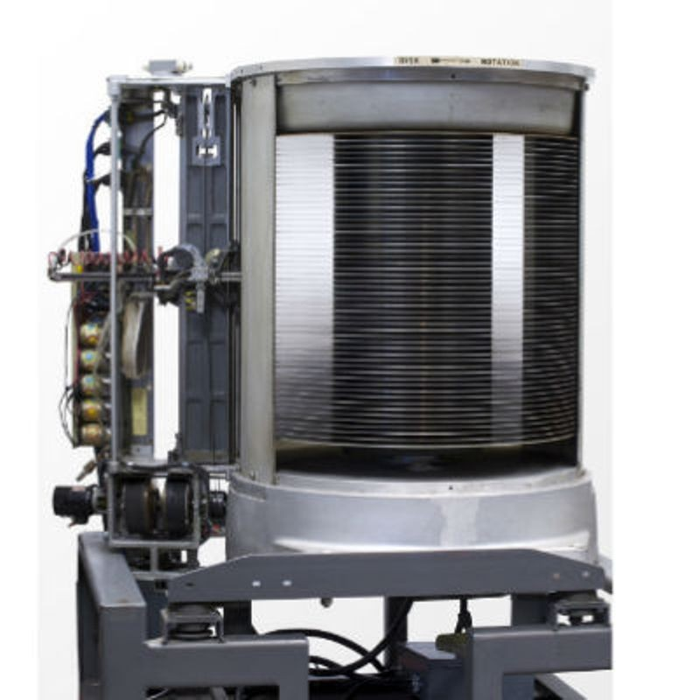
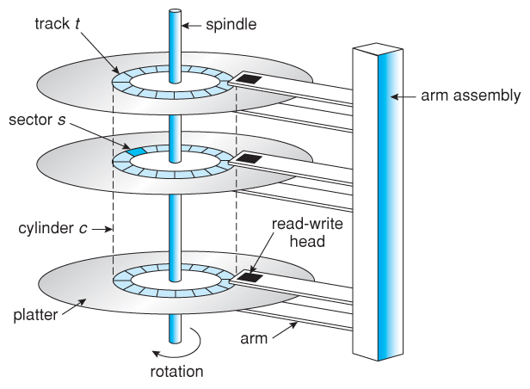

Mass Storage Devices
Mass storage refers to devices used for the storage and retrieval of bulk data by computer sysystems.
What constitutes “bulk data” depends on the state of the technology for a given era of mass storage
The first mass storage devices were disk drives, so-called because they used spinning disks of magnetic media with movable read/write heads.
The first disk drives were the size of washing machines, but were able to store massive amounts of information– 5 megabytes for IBM’s first model! [Hey, for the 1960’s, that was a staggeringly huge amount of data!]
Modern disk drives can store up to 26 terabytes of information on a single drive
Internals of first commercial disk drive made by IBM
Cutaway view of disk drive mechanical layout. Unchanged since the 1960’s.
Modern 3.5” disk drive internals

Slide 7
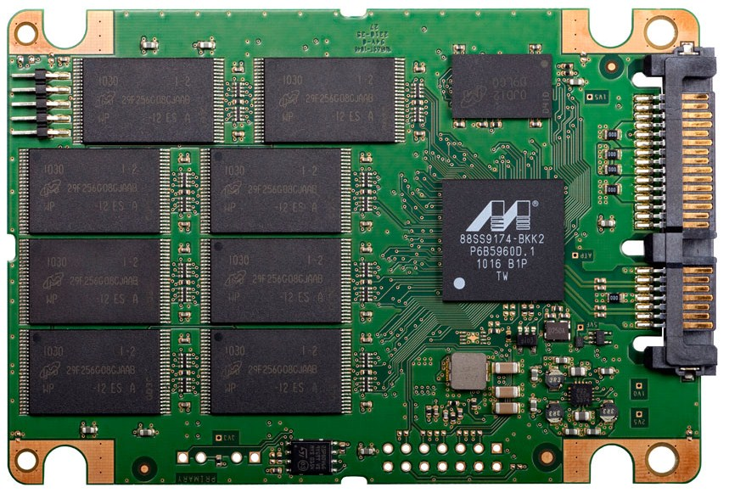
Mass Storage Devices (cont.)
As the density and cost of non-volatile NAND gate based silicon memory continues to drop, small flash memory USB jump drives and SD cards have evolved into full-fledged mass storage devices called Silicon Storage Devices (SSDs). SSD’s up to 100 terabytes in size have been constructed.
A modern NAND-flash based SSD with SATA connectivity. The chips at the left are the NAND flash chips, the chip at the right is the access controller.

Slide 8
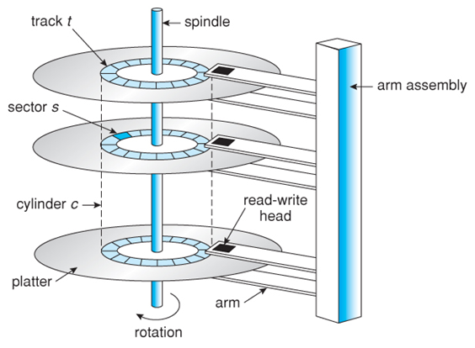
Mass Storage Filesystems
The original mechanical disk drives were random access, which meant that bytes could be written anywhere on the platters. This made them versatile, but also made storing data rather tricky.
Looking back at the construction of a traditional disk drive, notice that each platter is organized into tracks, and each track is broken up into sectors. All the sectors of all the tracks at a given position of the arm are called a cylinder.

Slide 9
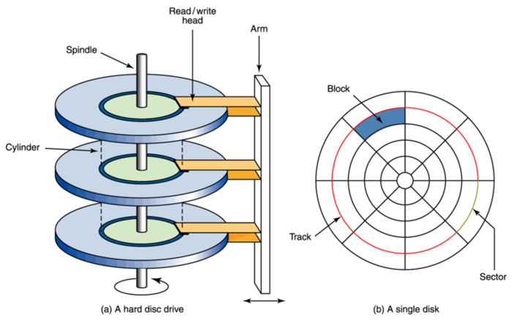
Mass Storage Filesystems
The original mechanical disk drives were random access, which meant that bytes could be written anywhere on the platters. This made them versatile, but also made storing data rather tricky.
Looking back at the construction of a traditional disk drive, notice that each platter is organized into tracks, and tracks are divided into sectors. The data at a given track and sector is called a block. All the blocks at a given position of the arm are called a cylinder.

Slide 10
Mass Storage Filesystems
A whole mess of different schemes were tried for organizing data on a disk drive
No sectors; each track was a block of a different size
Same number of sectors for each track (highly inefficient, but easy to code for)
Different number of sectors per track (preferred; this assures all blocks are the same size)
But the real challenge was how to organize the data on the disk
Present (“expose”) the underlying hardware to the user software, letting the software decide where to put what data
Present the storage on the drive as one big “pool” of bytes via a device driver, and let the software figure out how to use it
Break up the total storage of the drive into smaller chunks, and present those chunks to the user software (preferred)

Slide 11
Mass Storage Filesystems (cont.)
Once the data was organized, the next question was how to store and retrieve it– because how the data is stored can be different than how it is written or read
There are three methods for data access the world over:
Sequential: Related data (say, a graphic picture) is written and read sequentially to the mass storage device, from the first byte to the last
Random Access: Data may be retrieved in any order, then “reassembled” by the software. This approach also allows data to be written or read anywhere on the device at any time
Indexed: Data is broken up into records, and an index is used to keep track of which records are where on the physical disk
It is possible to combine these methods, which is what modern drives and operating systems do

Slide 12
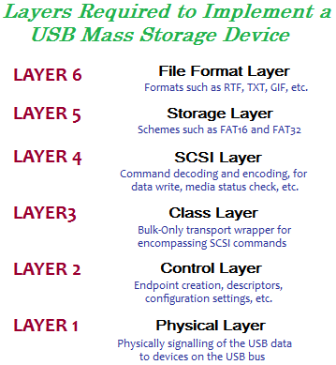
Mass Storage Filesystems (cont.)
The method for “chunking” data on a mass storage device for presentation to a computer is called a filesystem.
There are many, many different types of filesytem. All of them determine how the data on a mass storage device is organized, stored, and retrieved.
There are now many “layers” of software, firmware, and hardware between a computer and the filesystem on a modern mass storage device.
This “layer model” allows “abstraction” of the lower layers by the upper layers, so that software need only concern itself with related data (files) and how related data is organized (file formats.)

Slide 13
Generic Filesystem Architecture
Related data stored on a device is commonly referred to as a file, as an analogy to physical papers stored in a filing cabinet.
Files can be stored in one of two ways on a mass storage device:
Contiguous: All the data (bytes) of a given file are stored in physically adjacent blocks on the platter(s) of a drive
Random: The file data are dispersed across an arbitrary group of blocks on the drive

Slide 14
Generic Filesystem Architecture (cont.)
In either case, to allow the storage of multiple files, an index of some sort must be maintained to keep track of which file is stored where on a drive
There needs to be an “index to the index”, which is called variously the superblock or volume control block
The index in turn has various names: file index, catalog, or, more commonly, file allocation table (FAT)
The FAT contains entries for each file called inodes or file control blocks. The FCB’s contain:
The file name
File metadata: creation time, access time, and (optionally) permissions, owner, file type and access method for that file
The size of the file in blocks
Either:
A list of the blocks the file is using on the drive, that is, a map of which blocks make up the file and the order those blocks need to be accessed to reassemble the file (e.g. DOS FAT)
Just the first block the file is using, if the file is comprised of linked blocks (e.g. HFS)

Slide 15
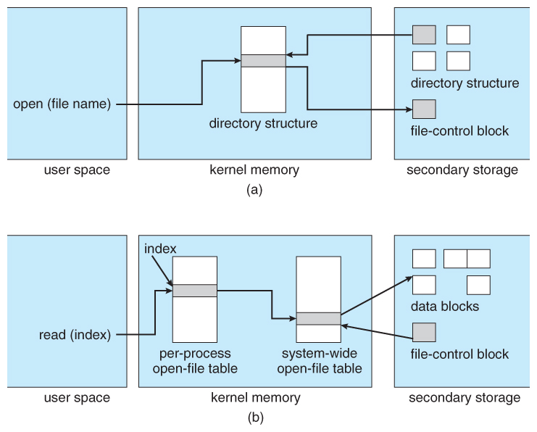
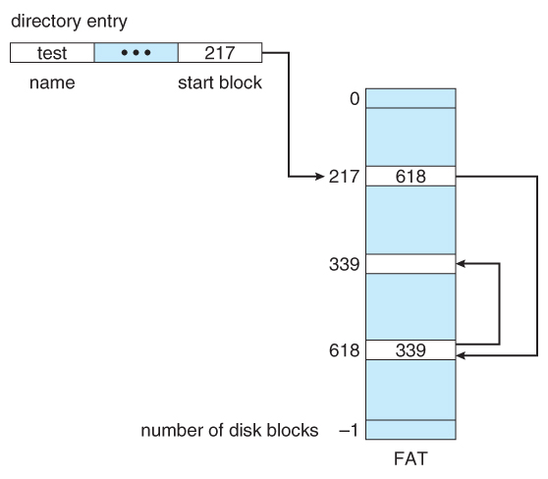
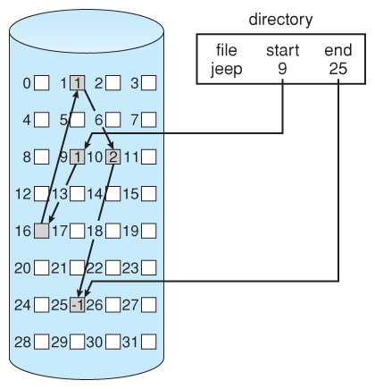
Generic Filesystem Architecture (cont.)
Modern operating systems abstract the details of the filesystem from user programs
This abstraction is performed by the device drivers in the operating system kernel (the part of the OS that is always in memory)
Typically, the directory structure of a given filesystem is cached into memory for easy access
When a process (program) opens a file, a filehandle is created which is a data structure that allows the program to communicate with the OS to read and write to the particular file that was opened.
Modern OS’s present most files to programs as a byte stream, leaving it up to the program to determine any additional formatting of the byte stream that may be needed.
Older OS’s could perform some pre-formatting of the byte-stream
DOS FAT
Linked
Allocation

Slide 16
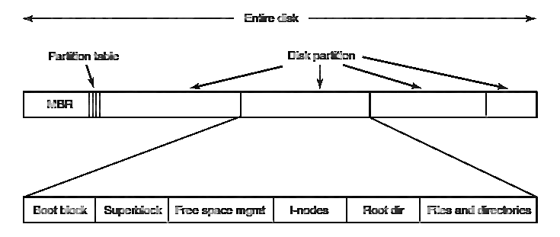
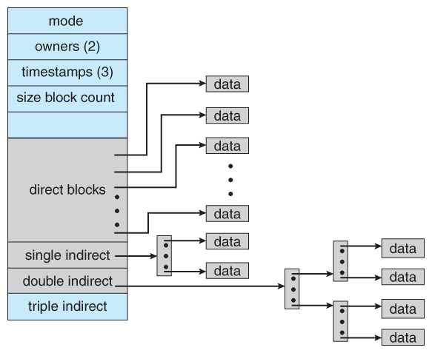
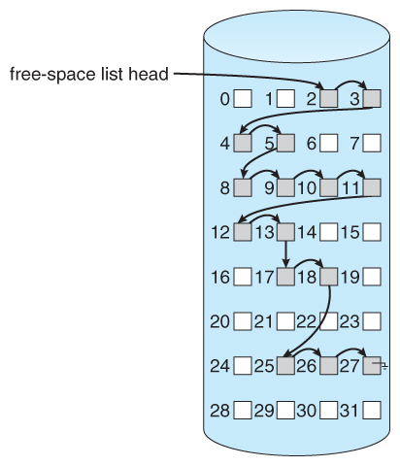
Linux Filesystem Architecture
Linux uses a very sophisticated filesystem called EXT4 (the fourth version since the original ext or ext1)
EXT4 uses combined indexing, which permits multi-level linking, allowing very large files
Multiple partitions, each containing it’s own ext4 filesystem, are possible
A Master Boot Record (MBR) is used to map the partition bootblock where OS startup code is located
A superblock provides a map of all the file inodes
Each inode is organized as shown at right, providing a linked list of the blocks in a given file
Free space is also a linked list of unused blocks
Linux inode
Free space management

Slide 17
The FAT Filesystem
The FAT file system originated around 1980 and is the filesystem that was first supported by MS-DOS. It was originally developped a simple filesystem suitable for floppy disk less than 500k bytes in size. Over the time, its specs has been expanded to support laeger media as increasing its capacity. FAT is the abbreviation of File Allocation Table, which is the array to manage allocation of data area and the name of the file system itself. Currently there are three FAT sub-types, FAT12, FAT16 and FAT32. These are developped in order of the number and completely backward compatible with older one. (FAT16 always include FAT12, FAT32 includes all FAT types)EXT4 uses combined indexing, which permits multi-level linking, allowing very large files
FAT sectors are 512 bytes in size; the term sector means the same thing as block
FAT uses logical volumes contained inside the physical storage volume (similar to multiple partitions on Linux)
A FAT logical volume consists of three or four areas, each of them consists of one or more sectors and located on the volume in order of as follows:
Reserved area (volume configuration data)
FAT area (allocation table for data area)
Root directory area (not present on FAT32 volume)
Data area (contents of file and directory)
The most important data structure in the FAT volume is BPB (BIOS Parameter Block), where the configuration parameters of the FAT volume are stored. The BPB is placed in the boot sector. The boot sector is often referred to as VBR (Volume Boot Record) or PBR (Private Boot Record), but it is simply the first sector of the reserved area, the first sector of the volume.
The another important area is FAT. What this structure does is define a linked list of the extents (cluster chain) of a file. Note that both directroy and file is contained in the file and nothing different on the FAT. The directory is really a file with a special attribute that indicates its content is a directory table.

Slide 18
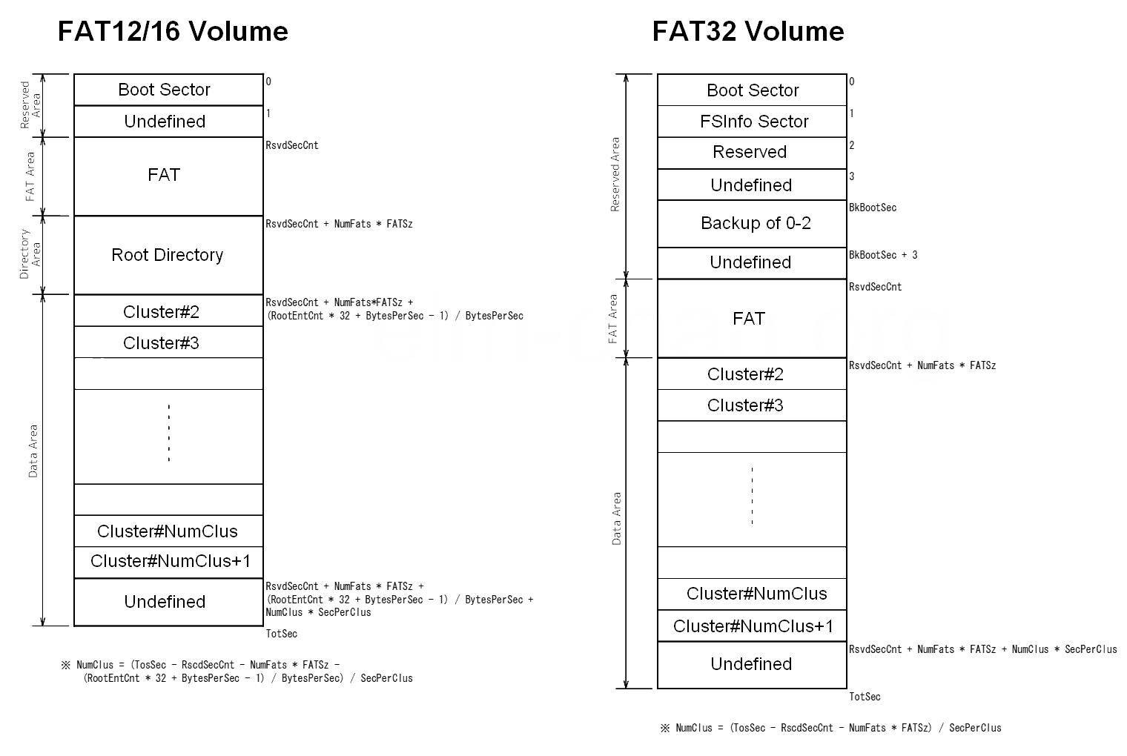
FAT Filesystem Types and SFNs
The FAT type (FAT12, FAT16 or FAT32) is determined by the count of clusters on the volume and NOTHING ELSE
A volume with count of clusters <=4085 is FAT12.
A volume with count of clusters >=4086 and <=65525 is FAT16.
A volume with count of clusters >=65526 is FAT32.
Short file name (SFN) is the basic feature of FAT volume. The directory is really a file with a special attribute. It contains table of directory entries that contain meta data of the files on the volume. Size of a directory entry is 32 byte long and it corresponds with a file or directory on the volume. Maximum size of a directory is 2 MB (65536 entries).
The SFN file name is stored in 8-byte body + 3-byte extension. The dot in the file name to separate body and extension is removed on the directory entry.

Slide 19
FAT Long File Names (LFN)
When add the long file name (LFN) as a new feature to the FAT filesystem, a backward compatibility with the existing systems is required. Following are concrete examples required.A volume with count of clusters <=4085 is FAT12.
The existence of LFN needs to be invisible on the existing systems, especially any file API on the MS-DOS and Windows.
LFN needs to be located physically near the direcroty entry of the corresponding file to prevent bad effect to the performance.
If disk utility found the LFN information recorded somewhere on the FAT volume, the filesystem needs to keep sanity and be not affected.
SFN, often called the 8.3 format name, is a traditional style file name originally used on the MS-DOS in format of body (1-8 character) plus optional extension (1-3 characters). These two parts are separated with a dot (.). The allowable charactes for the SFN are ASCII alphanumerics, some ASCII marks ($%'-_@~`!(){}^#&) and extended characters (\x80 - \xFF).
SFN is stored in the SFN entry in OEM code set (used on MS-DOS) depends on the system locale. Low-case character in the file name is converted to up-case and then stored and matched, so that the case information of SFN is lost.
Length of LFN can be up to 255 characters. The allowable characters for the LFN are white space and some ASCII marks (+,;=[]) in addition to the SFN characters. Dots can be embedded anywhere in the file name except the trailing dots and spaces are treated as end of the name and truncated off on the file API. Preceding spaces and dots are valid, but some user interface, such as Windows common dialog, rejects such file name.
LFN is stored in the LFN entry without up-case conversion. Character code used by LFN is in Unicode.
Because different character codes are used by SFN (OEM code set) and LFN (Unicode), generic implementation needs to convert those codes. This is not the matter on the OEM code is single byte code, however, when the OEM code page is in double byte character set (DBCS), a huge (several hundreds KB) conversion table is needed, so that it is difficult to implement LFN in the small embedded systems with a limited memory.

Slide 20
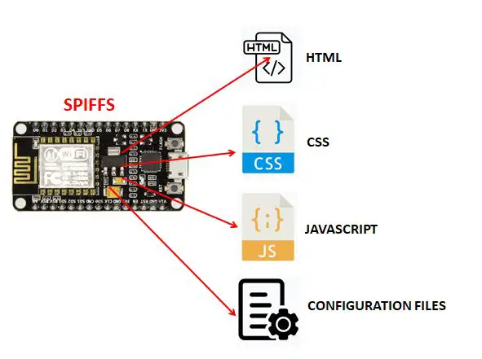
ESP8266 Flash Storage Architecture
The SPI accessed flash storage on the ESP8266 where Arduino binary code is stored is not erased when a new sketch is uploaded!
This means that the on-board flash can be used for the storage of persistent data– configuration files, web pages, what-have-you.
The filesystem format for storing this data is called SPIFFS – SPI Flash File System.
SPIFFS lets you access the flash chip memory like you would do in a normal filesystem in your computer, but simpler and more limited. You can read, write, close, and delete files. SPIFFS doesn’t support directories, so everything is saved on a flat structure.
Using SPIFFS, you can:
Create configuration files with settings;
Save data permanently;
Create files to save small amounts of data instead of using a microSD card;
Save HTML and CSS files to build a web server;
Save images, figures and icons;
And much more.
Before you can begin using SPIFFS, we will need to install a file upload plugin for the Arduino IDE

Slide 21
Arduino File Uploader Installation https://randomnerdtutorials.com/install-esp8266-filesystem-uploader-arduino-ide/
Go to the Tools directory of the Arduino IDE. You will do this in your file explorer, not the IDE!
Windows 7 Path (see below for Win 10): Computer\C:\Program Files (x86)\Arduino\tools
Linux Path: /usr/local/src/arduino-1.8.19/tools
Copy the following file from your Lesson 5 directory or your Software directory to the arduino/tools directory: ESP8266FS-0.5.0.zip
Unzip the file into the tools directory; you should get the following: <home_dir>/Arduino-<version>/tools/ESP8266FS/tool/esp8266fs.jar
Start (or restart if you got ahead) your Arduino IDE
To check if the plugin was successfully installed, open your Arduino IDE and select your ESP8266 board. In the Tools menu check that you have the option “ESP8266 Sketch Data Upload“.
Win10
Kubuntu
Win7

Slide 22
Formal End of Lesson 5
HOMEWORK
Review SPIFFS usage per https://randomnerdtutorials.com/install-esp8266-filesystem-uploader-arduino-ide/
In next week’s exciting episode
Review of WiFi technology (but no gory details)
Class Exercise: Review of WiFi access with WiFi Manager
Uploading a web page using SPIFFS
Class Exercise: Create a basic web server

Slide 23
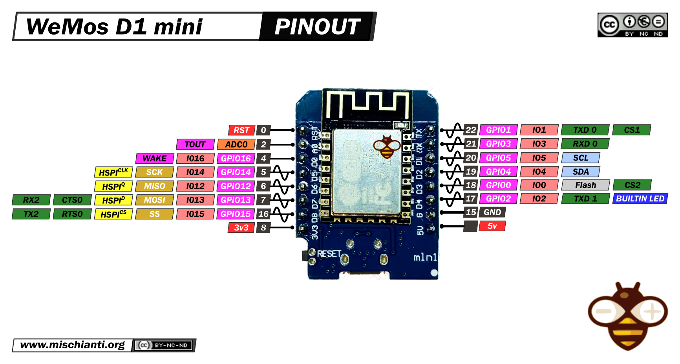
Our Microcontroller: The WeMos D1 Mini
Hilights
11 digital IO: all are interrupt and pwm capable (except D0/GPIO16)
1 analog input (3.2V max input): A0/ADC0
Micro USB or Type-C USB Port (clones usually have micro USB)
Two SPI interfaces (one is used for on-board flash memory), one I2C interface, two serial ports
Built-in WiFi (client or standalone access point modes) and Bluetooth
Compatible with MicroPython, Arduino, NodeMCU
Uses the CH340 USB-to-serial driver (installation usually needed on Windows)
Extremely low cost (approx $3.00 US on Amazon; one of the two least expensive components in your kits)

Slide 24
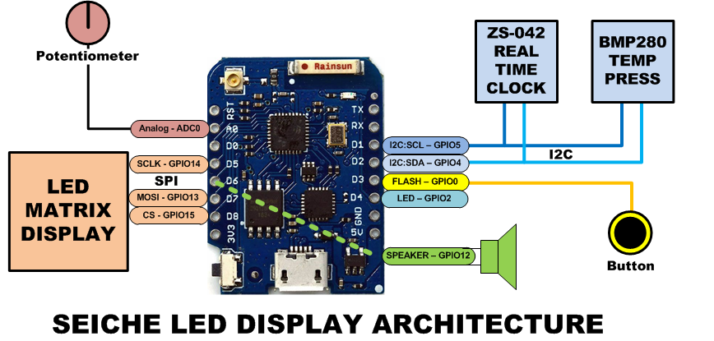
SEICHE LED Display Architecture
Red MAX7219 8x32 LED matrix display (SPI)
ZS-042 real-time clock module (I2C)
BMP280 Temperature and Pressure Sensor (I2C)
Piezoelectric speaker (PWM)
10KΩ Potentiometer (Analog-to-Digital Converter)
Button (Pullup and interrupt)

Slide 25
sprintf() Function Syntax
sprintf()’s formal syntax is: sprintf(char *buffer, const char *format, variable list)
buffer is an array of type char (the parameter when passed can also be a pointer [address] for such an array) which will contain the formatted output of the function
format is an unmodifiable (constant) array of char containing the format descriptors for all variables subsequently passed to the function, which is to say, it’s the format string.
The variable list are just the comma separated variables that are to be formatted
All variables passed in a single call to sprintf() are combined into a single output string
sprintf() automagically puts a terminating NULL (\0) at the end of the ASCII output

Slide 26
sprintf() Format Strings
sprintf() format strings contain conversion specifiers that specify how each individual variable is to be converted
sprintf() conversion specifiers have the following general syntax (all begin with a percent-sign):
%[flags][minimum field width][.][precision][length][conversion character]
% - special token that indicates the start of a conversion specifier
Flags – these modify the behavior of the specification
Minumum field width – as it says on the tin; this the minimum number of characters to be converted
. – The period is a separator between field width and precision
Precision – means one of the following depending on the variable type and conversion specifier
The maximum number of characters to be generated from a string
The number of digits after the decimal point for type float conversions (e, E, or f)
The zero-filled minimum number of digits for an integer
Conversion character – A single character which determines the output type of the conversion specifier; a single character that specifies the type of output format for the corresponding data or variable

Slide 27
sprintf() Conversion Specifiers
Below are the general conversion specifiers and what they do.
Specifier | What it does
d, i | int - integer; signed decimal notation
o | int – unsigned octal (no leading zero)
x, X | int – unsigned hexadecimal, no leading 0x
u | int – unsigned decimal
c | int – single character, after conversion to unsigned char
s | char * - characters from string are printed until \0 (NULL) or precision is reached
f | double – decimal notation of form [-]mmm.ddd where number of decimals is specified by precision; precision of zero (0) suppresses the decimals altogether
e, E | double - exp notation; default precision of 6, 0 suppresses
g, G | double – Use %f for <10^4 or %e for >10^4
p | void * - print output as a pointer, platform dependent
n | Number of characters generated so far; goes into output
% | No conversion, put a % percent sign in the output

Slide 28
sprintf() Conversion Specifiers
Below are the flags and what they do.
Flag | What it does
- | Left justification
+ | Always print number with a sign
spc (space) | Prefix a space if first character is not a sign
0 (zero) | Zero fill left for numeric conversions
# | Alternate output form depending on conversion character o – first digit will be zero x or X – 0x or 0X (respectively) prefixed to non-zero results e, E, f, g and G – Output will always have a decimal point g and G – trailing zeroes will never be removed

